Slide 1
Ecology 8310
Population (and Community) Ecology
Seguing into from populations to communities
    Species interactions
    Lotka-Volterra equations
    Competition
    Adding in resources
Notes:
Foraging theory had it's hay-day in 1970's and early 80's. Not common today, but the basis of the theory remains with us; engrained in how we model systems and think about consumer-resource interactions and spatial dynamics.

Slide 2
Species interactions:
Competition (- , -)
Predation (+ , -)
  (Herbivory, Parasitism, Disease)
Mutualism (+ , +)
None (0 , 0)

Slide 3
Species interactions:
a_{ij}>0
a_{ij}<0
6
5
a₁₆
a_{ij} gives the per capita effect of species j on species i’s per capita growth rate, dN_{i}/N_{i}dt
a₁₅
4
a₁₄=0
1
a₁₂
a₁₃
2
a₁₁
3

Slide 4
Generalized Lotka-Volterra system:
Special cases:
Exponential model: all a’s=0
Logistic model: a_{ii}<0; others =0

Slide 5
dN₁/N₁dt
Slope = a₁₂
Slope = a₁₁
N₂
N₁

Slide 6
dN₁/N₁dt
Slope = a₁₂
Slope = a₁₁
N₂
N₁

Slide 7
Species interactions:
a_{ij}>0
a_{ij}<0
1
a₂₁
a₃₁
a₁₂
a₁₃
2
a₁₁
3
a₄₃
a₃₄
4
a₄₄
What can you say about the interactions between these species?
Which are interspecific competitors?
Which are predator and prey?
Which are mutualists? Which show self limitation?

Slide 8
Competition:
Arises when two organisms use the same limited resource, and deplete its availability
(intra. vs. interspecific)
a₂₁
1
a₁₂
2
a₁₁
a₂₂
1
2
Alternate terminology:
α_{ij} = a_{ij}/a_{ii} , the effect of interspecific competition relative to the intraspecific effect (e.g., how many of species i does it take to have the same effect as 1 individual of species j?)
R

Slide 9
Competition:
a₂₁
1
a₁₂
2
a₁₁
a₂₂

Slide 10
Competition:
a₂₁
1
a₁₂
2
a₁₁
a₂₂
Can we use this model to understand patterns of competition among two species (e.g., coexistence and competitive exclusion)?
E.g., Paramecium experiments by Gause…

Slide 11

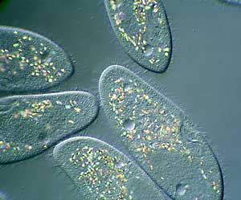
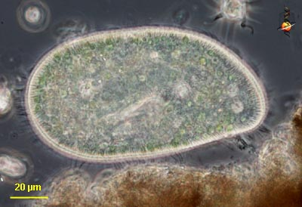
Classic studies of resource competition by Gause (1934, 1935)
Paramecium caudatum
Paramecium aurelia
Paramecium bursaria

Slide 12
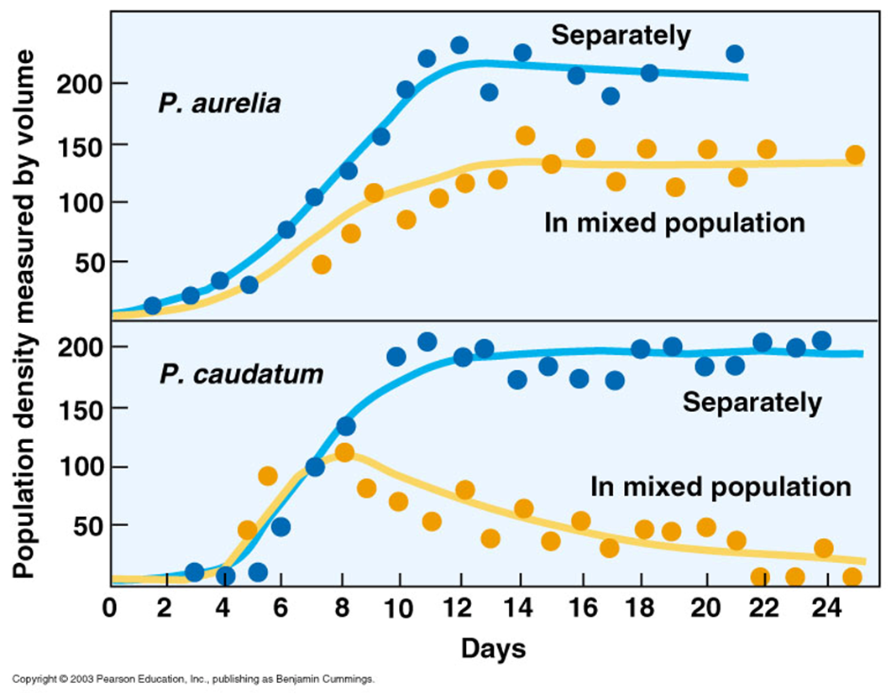
Competitive exclusion:
P. aurelia excludes P. caudatum

Slide 13
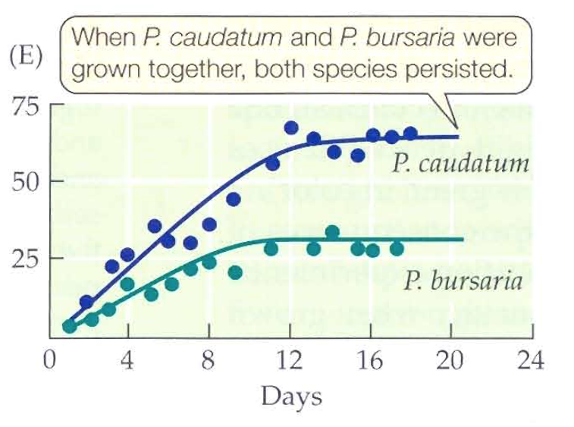
In contrast…
Paramecium caudatum
Why this disparity, and can we gain insights via our model?
Paramecium bursaria

Slide 14
Competition:
a₂₁
1
a₁₂
2
a₁₁
a₂₂

Slide 15
Competition:
At equilibrium, dN/Ndt=0:

Slide 16
Phase planes:
Graph showing regions where dN/Ndt=0 (and +, -); used to infer dynamics
Species 1’s zero growth isocline…
K₁/α₁₂
N₂
dN₁/N₁dt=0
N₁
K₁

Slide 17
Phase planes:
What if the system is not on the isocline. Will what N₁ do?
K₁/α₁₂
N₂
dN₁/N₁dt=0
N₁
K₁
Notes:
Magnitudes indicate relative size of dN/dt – discuss why the vectors differ in magnitude.

Slide 18
Phase planes:
dN₂/N₂dt=0
K₂
N₂
N₁
K₂/α₂₁

Slide 19
Phase planes:
Putting it together…
K₂
dN₂/N₂dt=0
Species 2 “wins”:
N₂* =K₂, N₁* =0
(reverse to get Species 1 winning)
K₁/α₁₂
N₂
dN₁/N₁dt=0
N₁
K₁
K₂/α₂₁

Slide 20
Phase planes:
Your turn…. For A and B:
Draw the trajectory on the phase-plane
Draw the dynamics (N vs. t) for each system.
K₂
dN₂/N₂dt=0
A
K₁/α₁₂
N₂
B
dN₁/N₁dt=0
N₁
K₁
K₂/α₂₁

Slide 21
Phase planes:
Another possibility…
K₂
dN₂/N₂dt=0
“It depends”: either species can win, depending on starting conditions
K₁/α₁₂
N₂
dN₁/N₁dt=0
N₁
K₂/α₂₁
K₁

Slide 22
Phase planes:
Your turn….
Draw the dynamics (N vs. t) for the system that starts at:
Point A
Point B
K₂
A
K₁/α₁₂
N₂
B
dN₁/N₁dt=0
N₁
K₂/α₂₁
K₁

Slide 23
Phase planes:
Now do it for many starting points:
Separatrix or manifold
K₂
K₁/α₁₂
N₂
dN₁/N₁dt=0
N₁
K₂/α₂₁
K₁
Notes:
Manifold is straight if r1=r2, but bent otherwise

Slide 24
Phase planes:
A final possibility…
dN₁/N₁dt=0
K₁/α₁₂
Coexistence!
N₂
K₂
dN₂/N₂dt=0
N₁
K₁
K₂/α₂₁

Slide 25
Phase planes:
“Invasibility”…
Mutual invasibility ➔ coexistence!
Why: because each species is self-limited below the level at which it prevents growth of the other
K₁/α₁₂
dN₁/N₁dt=0
N₂
K₂
dN₂/N₂dt=0
N₁
K₁
K₂/α₂₁

Slide 26
Invasibility:
Contrast that with…
K₂
dN₂/N₂dt=0
Neither species can invade the other’s equilibrium (hence no coexistence).
K₁/α₁₂
N₂
dN₁/N₁dt=0
N₁
K₂/α₂₁
K₁

Slide 27
Coexistence:
K₁/α₁₂
dN₁/N₁dt=0
N₂
K₂
dN₂/N₂dt=0
N₁
K₁
K₂/α₂₁
Notes:
Necessary, not sufficient…. (depends on K’s also)

Slide 28
Coexistence:
“intra > inter”
Coexistence requires that the strength of intraspecific competition be stronger than the strength of interspecific competition.
Resource partitioning
Two species cannot coexist on a single limiting resource

Slide 29
Can we now explain Gause’s results?
Bacteria in water column
Yeast on bottom
Paramecium caudatum
Paramecium aurelia
Paramecium bursaria

Slide 30
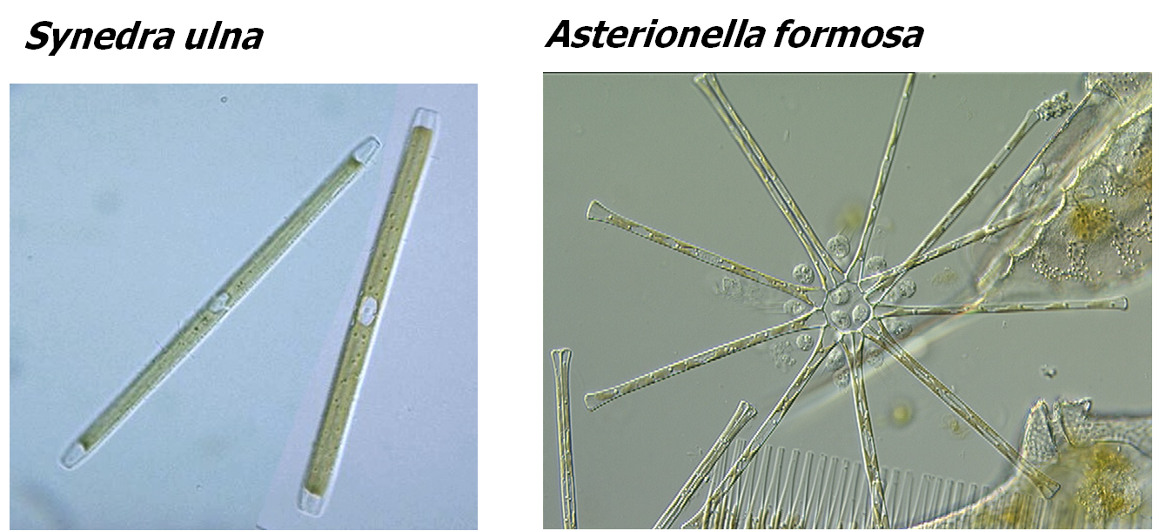
Resources:
But what about resources?
(they are “abstracted” in LV model)
Research by David Tilman

Slide 31
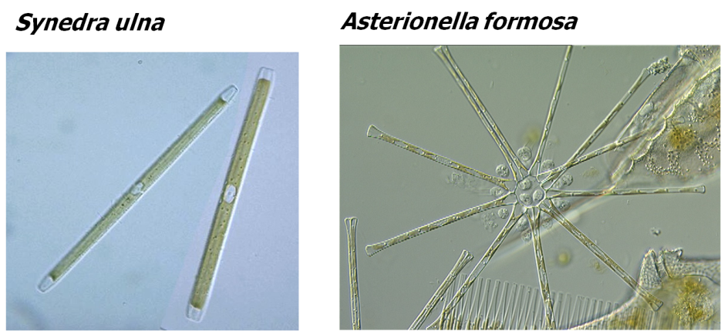
Resources:
Followed population growth
and resource (silicate) when alone:
Data = points.
Lines = predicted from model

Slide 32
Resources:
What will happen when growth together: why?

Slide 33
Resources:
R*: resource concentration after consumer population equilibrates (i.e., R at which Consumer shows no net growth)
Species with lowest R* wins (under idealized scenario: e.g., one limiting resource).
If two limiting resources, then coexistence if each species limited by one of the resources (intra>inter): trade-off in R*s.

Slide 34
Next time: Tilman's R* framework

