Slide 1
Ecology 8310 Population (and Community) Ecology
A quick review of evolution…
Classic example: Biston betularia
Evolution by natural selection
Population genetics
Quantitative genetics
Breeder's equation
Selection
Notes:
Foraging theory had it's hay-day in 1970's and early 80's. Not common today, but the basis of the theory remains with us; engrained in how we model systems and think about consumer-resource interactions and spatial dynamics.

Slide 2
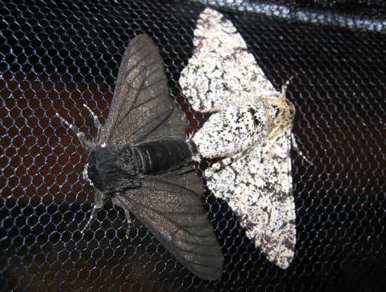
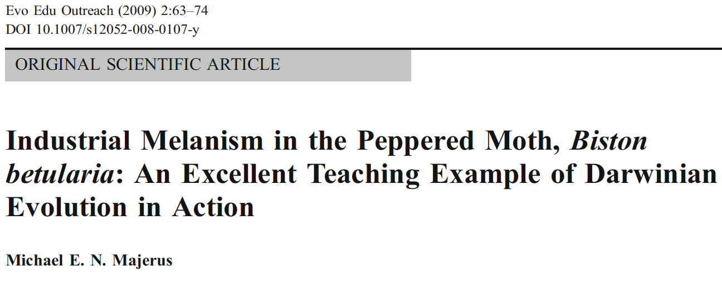
Evolution examples: Biston betularia
Heredity (1955) 9, 323–342
doi:10.1038/hdy.1955.36

Slide 3
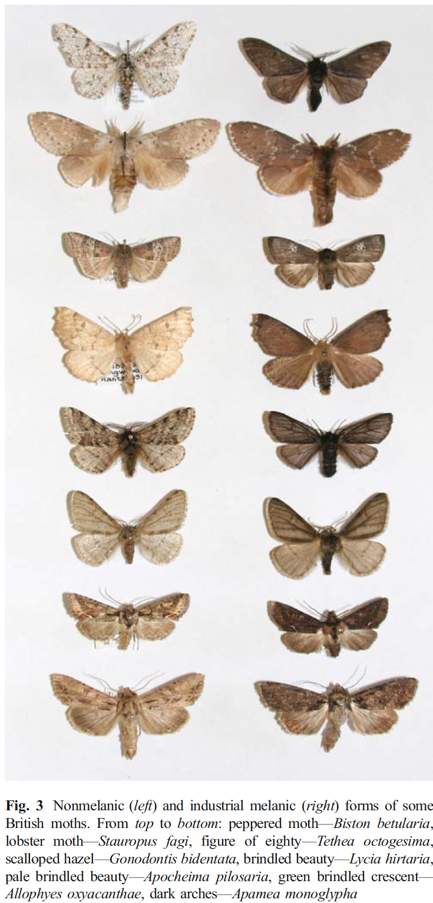
The story:
Notes:
Classic example with a storied past:
Two form: dark (carbonaria) and light typica, which is "normal"). Dark form described first around Glouchester in 1848. Dark morph became common around industrialized centers of England and by late 1800's is was the most common form (98% of moths).
Tutt first proposed this was driven by natural selection caused by increased industrial activities.
Kettlwell performed classic experiments exploring the mechanisms responsible in the 1950s.
Story: Normal situation: trees with lichens; typica blends in.
Industrialization: led to soot deposition on trees, killed lichens, dark branches.
As a result, typical stood out to visual predators (birds); natural selection favored dark morphs after industralization
Sargent in the 1960's was unable to replicate Kettlewell's finding – leading to controversy, debate, and charges of data fabrication, etc. Fascinating.
Majerus revisited in 2000's and re-affirmed Kettlewell's work – it's stands today as one of the classic examples of evolution by natural selection.
Common pattern acros a wide range of British moths.

Slide 4
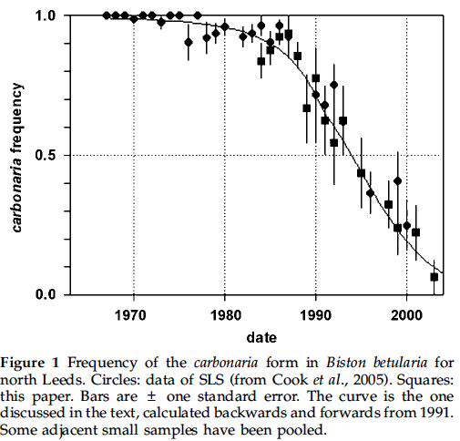
Post-industrialization?

Slide 5
Evolution by natural selection:
What is required?
Phenotypic (trait) variation
Differential survival or reproduction (selection)
Trait must be heritable

Slide 6
Evolution by other means?
Genetic drift
Mutation
Migration
Genetic drift and natural selection both require variation.
Mutation and migration introduce variation.
Examine natural selection more closely

Slide 7
Population genetics (few genes)

Slide 8
Population genetics approach:
Single gene involved
carbonaria allele is dominant
How can we approach this?
You homework assignment…
Geno-type | Pheno-type | Freq. | Fitness
AA | dark | p² | w₁
Aa | dark | 2pq | w₂
aa | light | q² | w₃
Notes:
P2 etc. works when there is random mating, large popu size (no sampling error), two alleles, discrete generations (non-overlapping), no mutation, no migration, and sexes have equal allelic frequency,

Slide 9
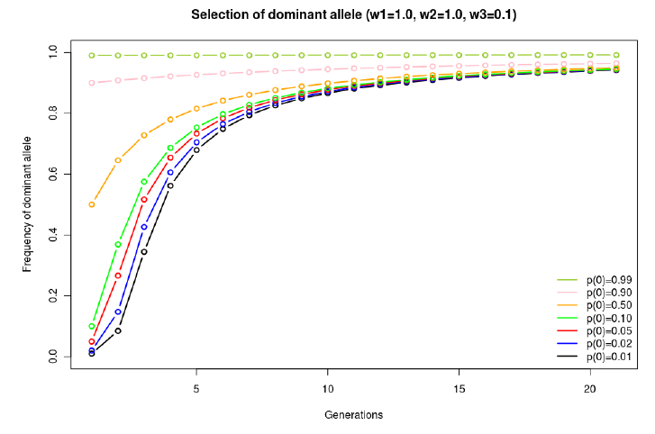
Evolutionary dynamics:
w₁=w₂=1.0; w₃=0.1

Slide 10
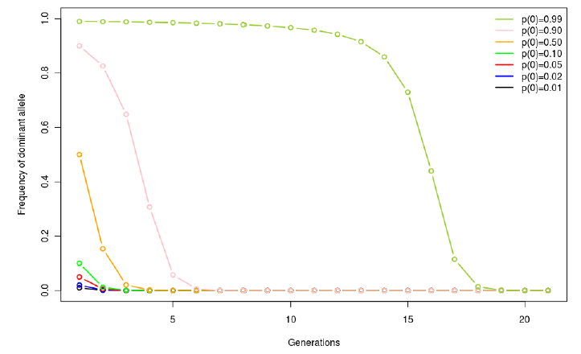
Evolutionary dynamics:
w₁=w₂=0.1; w₃=1.0
Notes:
Note that rate is slower than in first case because the effect of the recessive allele is "hidden" – when it's rare it is primarily in the heterozy state. Thus, the primary phenotype associated with allele a is "dark": i.e., Aa (rather than aa, which would be light). Thus, there is very LITTLE PHENOTYPIC VARiATION to act upon. In general, change is rapid when p=q=.5 because the phenotypic variation is largest.

Slide 11
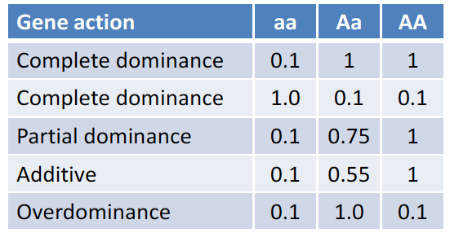
Other patterns of "dominance":
Notes:
P2 etc. works when there is random mating, large popu size (no sampling error), two alleles, discrete generations (non-overlapping), no mutation, no migration, and sexes have equal allelic frequency,

Slide 12
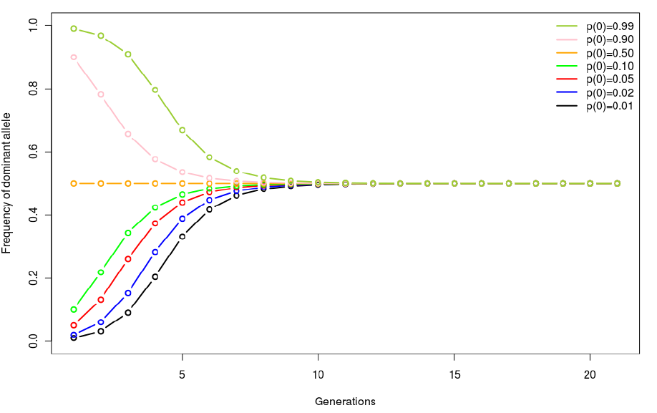
Evolutionary dynamics:
w₁=0.3; w₂=01.0; w₃=0.3

Slide 13
Quantitative (continuously varying) traits

Slide 14
Response to selection:
Notes:
Breeder's equation. Captures the two processes of evolution by selection: S (selection intensity) and heritability, h2. Both are required to get a response to selection (i.e., evolution via selection).
Notice also that this makes clear that selection ACTS ON THE PHENOTYPE!!!

Slide 15
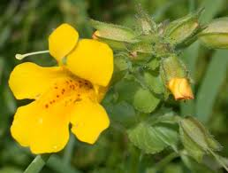
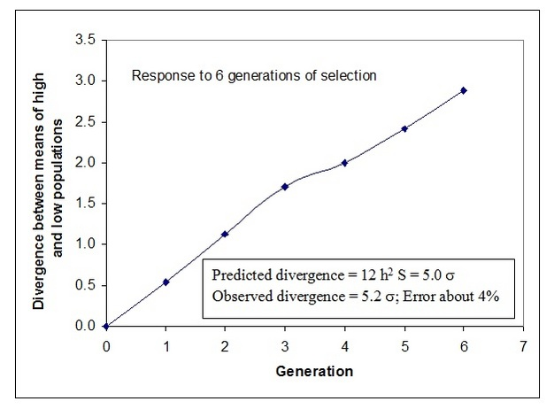
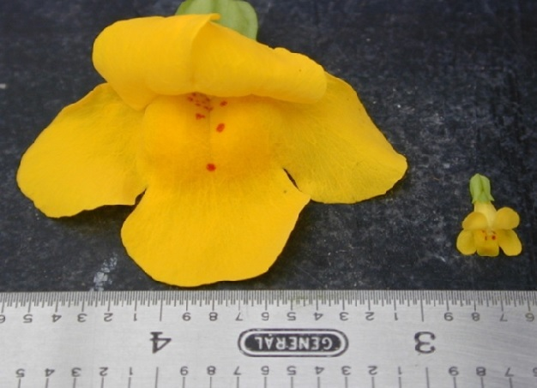
Response to selection:
From Kelly (2008)
Notes:
Kelly imposed selection: top 20% or bottom 20% of corolla widths were allowed to breed…. Continued for 6 generations. High and Low lines diverged; and rate was apprx as expected based on S and heritability.

Slide 16
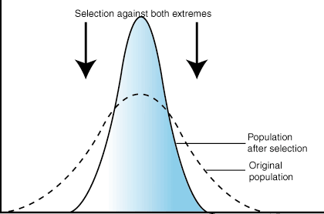
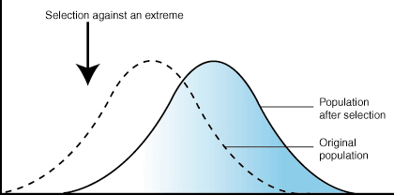
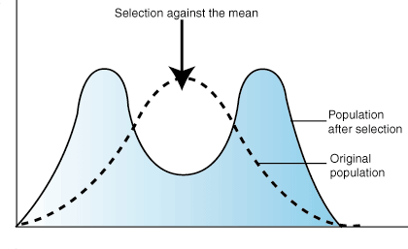
Forms of selection:
Stabilizing
Directional
Disruptive

Slide 17
Selection gradients:
Stabilizing
Directional
Disruptive
Relative Fitness
Phenotype
Relative Fitness
Relative Fitness
Phenotype
Phenotype

Slide 18
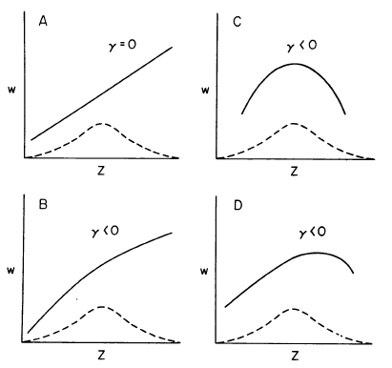
Selection gradients: quantification
Selection differential:
Selection gradients:
W = β₀ + β₁z + γ z²
Which is directional?
Which is stabilizing?
Disruptive?
From Mitchell-Olds and Shaw (1987)

Slide 19
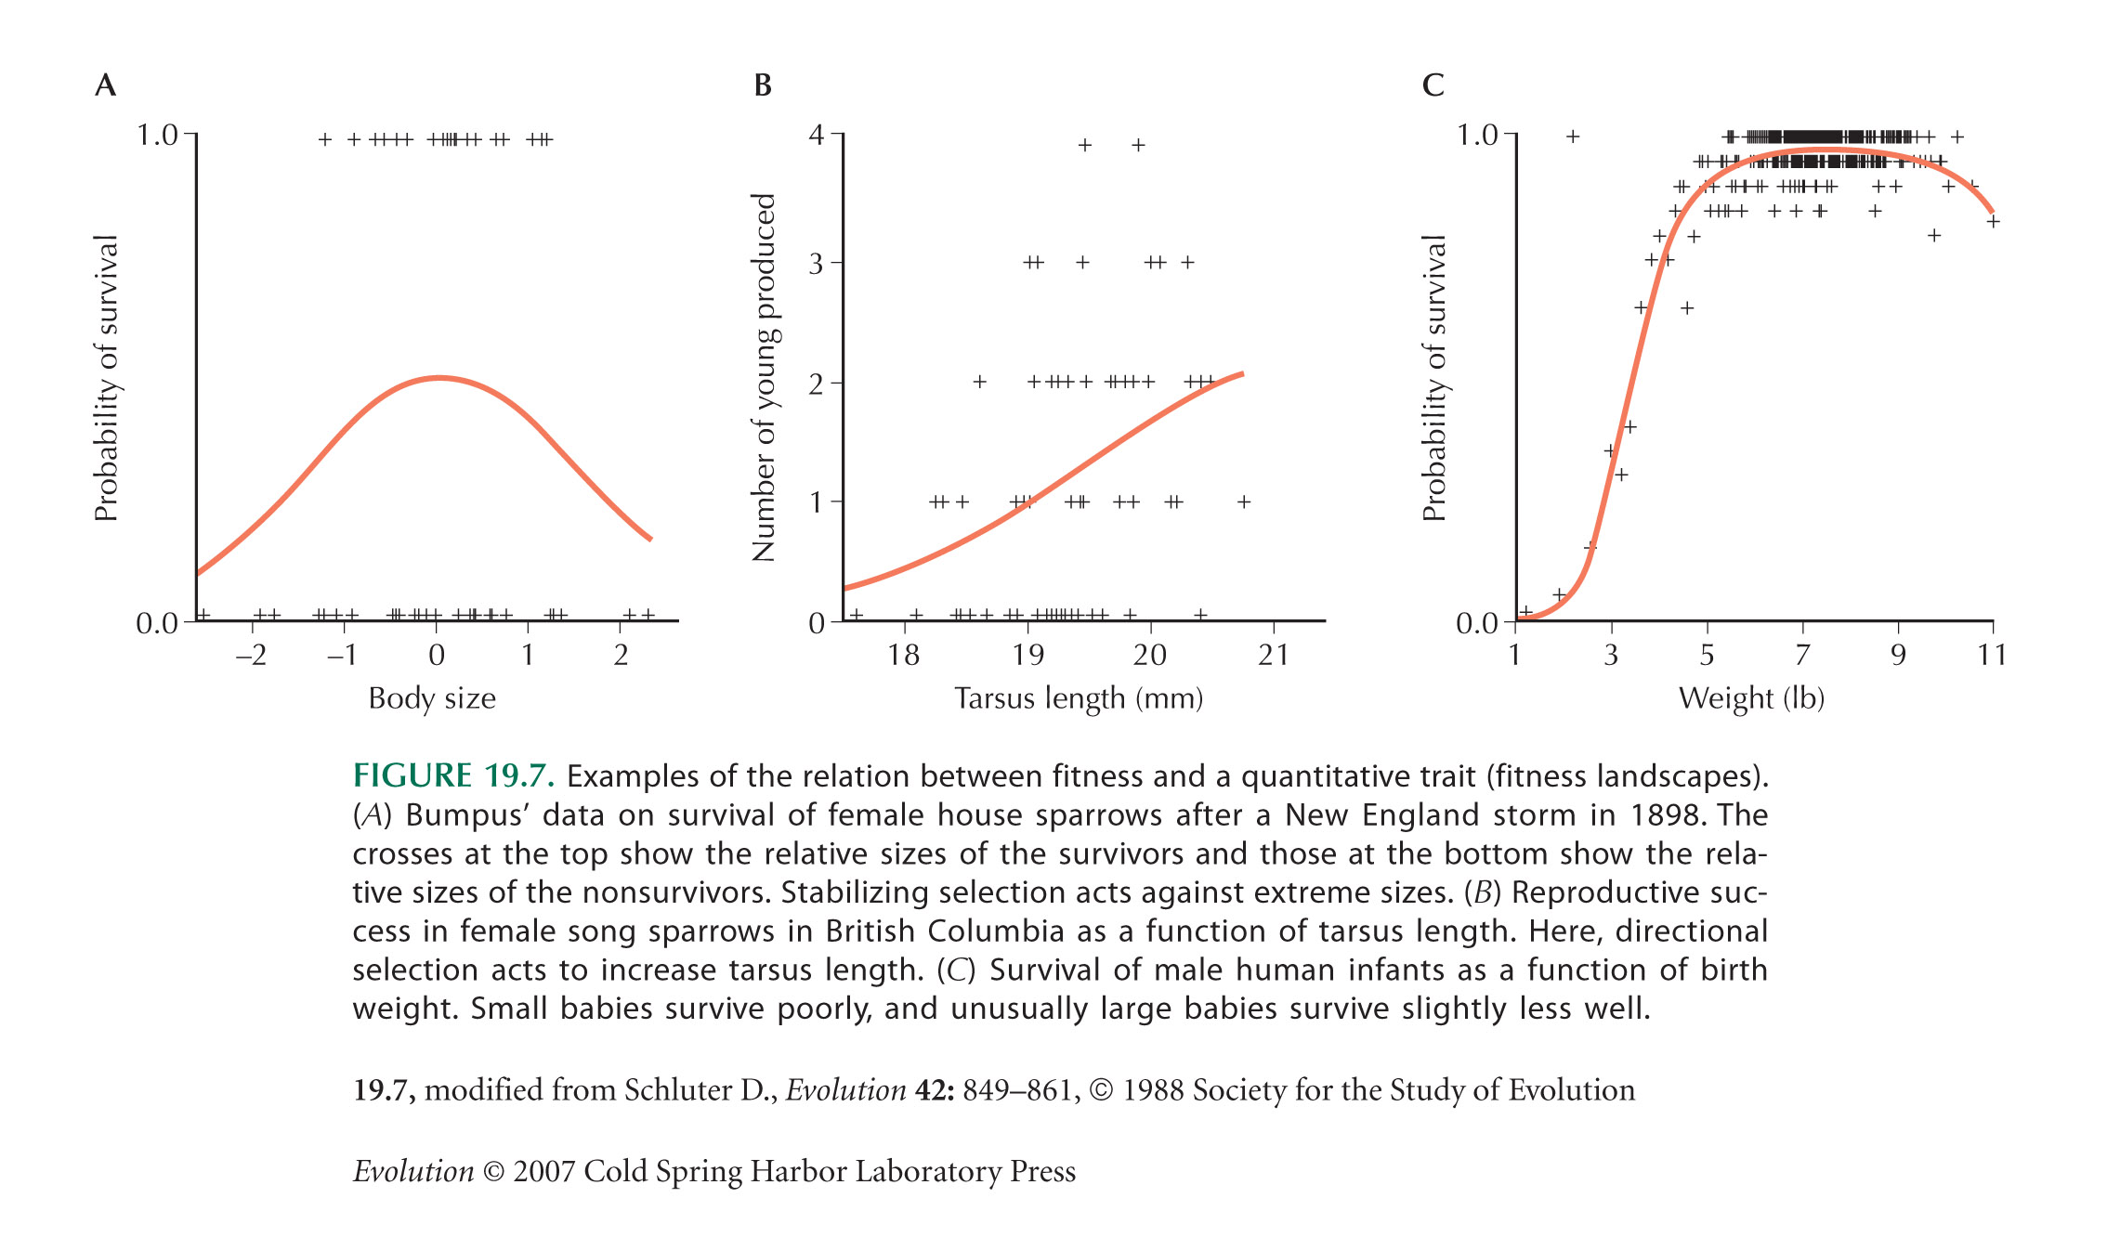
Examples:

Slide 20
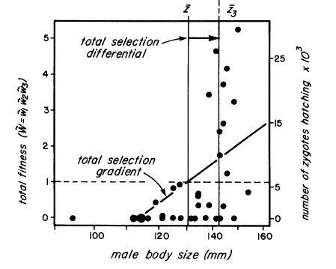
Another example:
From Arnold and Wade 1984 (data from Howard 1979)

Slide 21
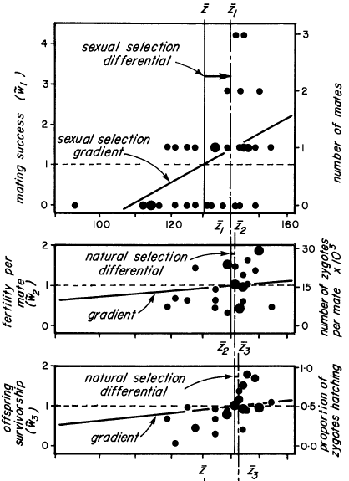
Components
of fitness:
e.g.,
w = mating success
x
fertility/mate
x
offspring survival

Slide 22
Selection is an ecological process

